Slide 1
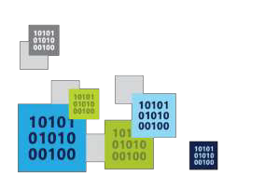
Intro to Azure
Trilok Chowdary
Program manager
Codepixel

Slide 2

Why the cloud?

Slide 3
Why the cloud?
On Premises
Infrastructure
(as a Service)
Platform
(as a Service)
Software
(as a Service)
Applications
You manage
You scale, make resilient and manage
You scale, make resilient & manage
Scale, resilience and management by vendor
Scale, resilience and management by vendor
Managed by vendor

Slide 4
Azure

Slide 5
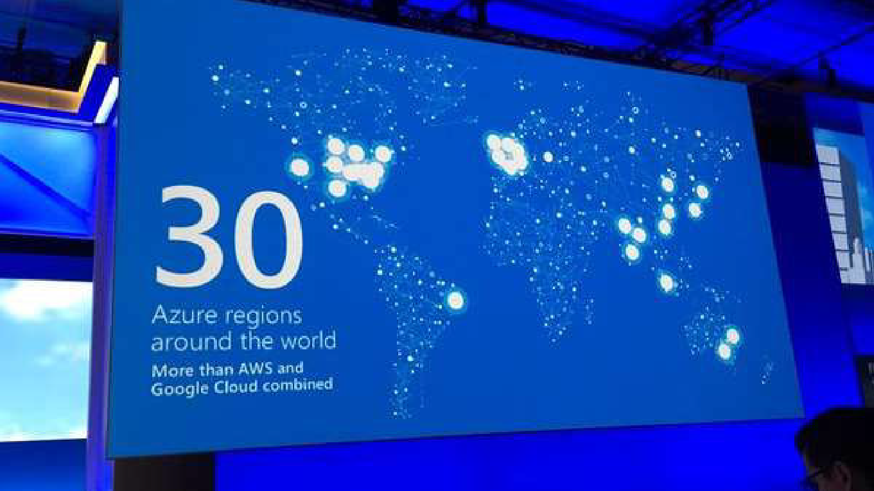
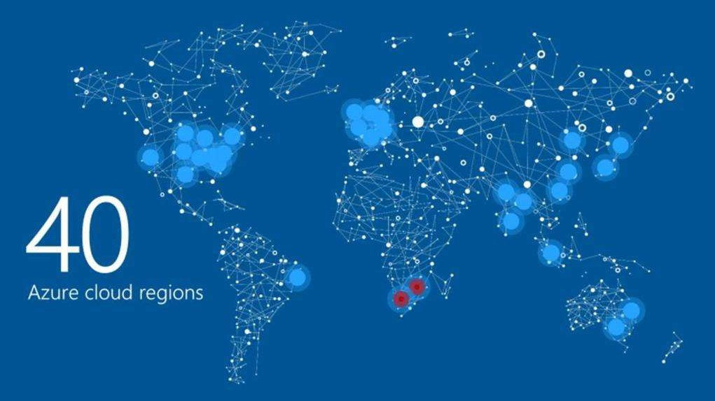
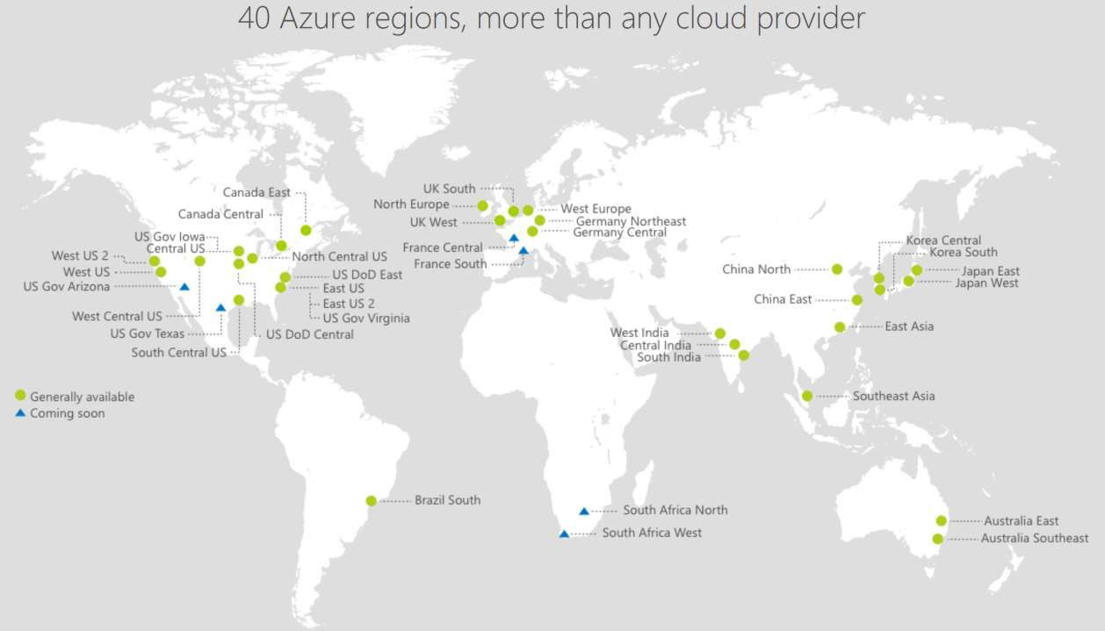


17 regions worldwide in 2015
Azure footprint
Data Centers Regional Partners
Source: https://twitter.com/PaulSpain/status/715564339114053632

Slide 6
Demo: Azure Portal

Slide 7
Azure Services

Slide 8
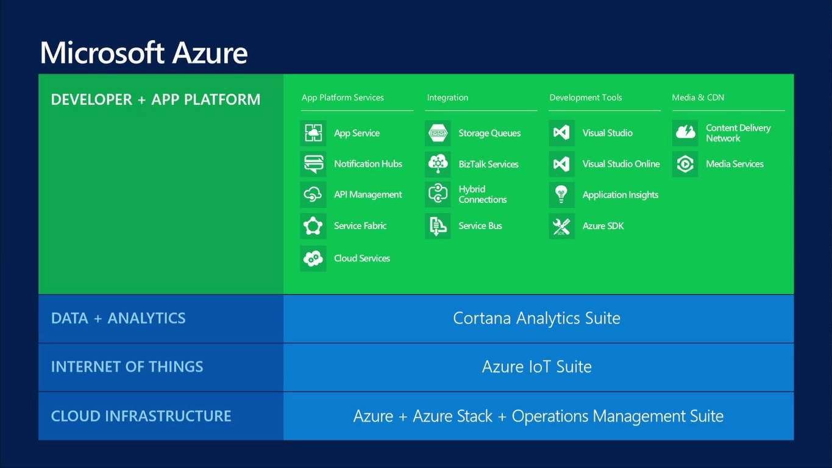

Slide 9
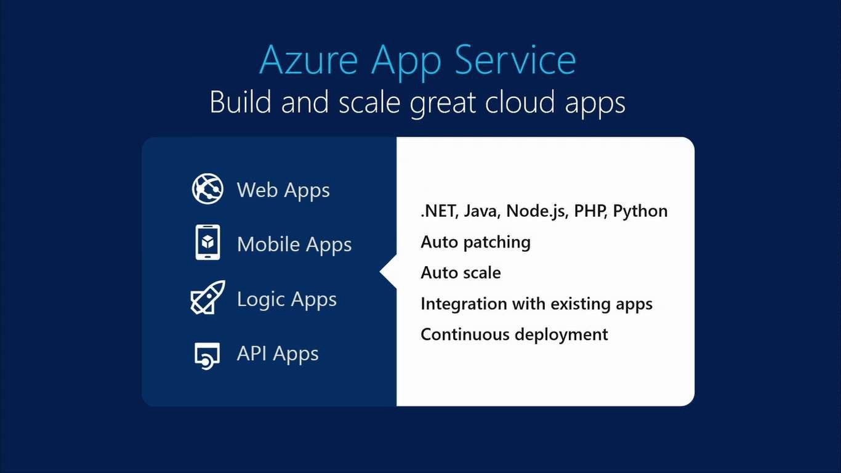

Slide 10
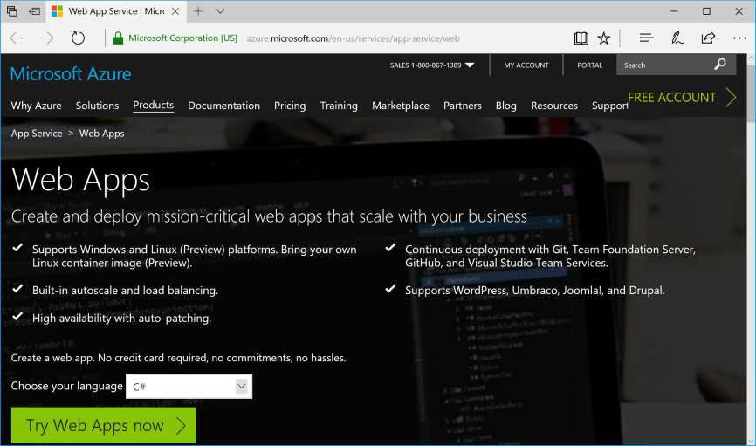
Web Apps
Languages:
.NET
Java
PHP
Node.js
Python
https://azure.microsoft.com/en-us/services/app-service/web/

Slide 11
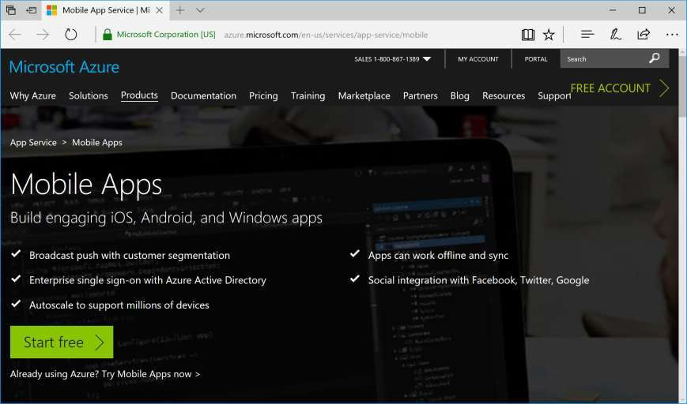
Mobile Apps
Platforms:
iOS
Android
Windows
https://azure.microsoft.com/en-us/services/app-service/mobile/

Slide 12
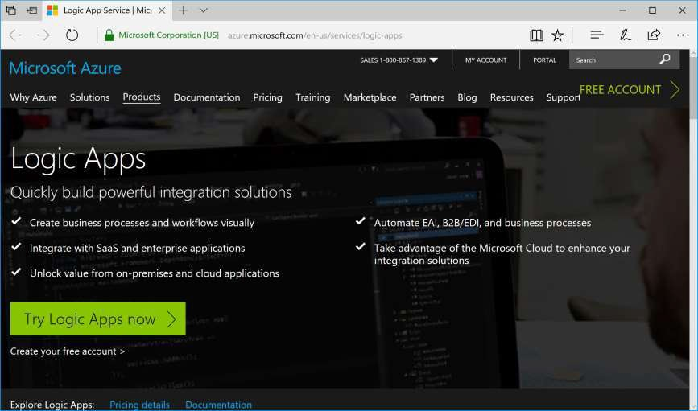
Logic Apps
Features:
Integrate
Automate
Connect
https://azure.microsoft.com/en-us/services/app-service/logic/

Slide 13
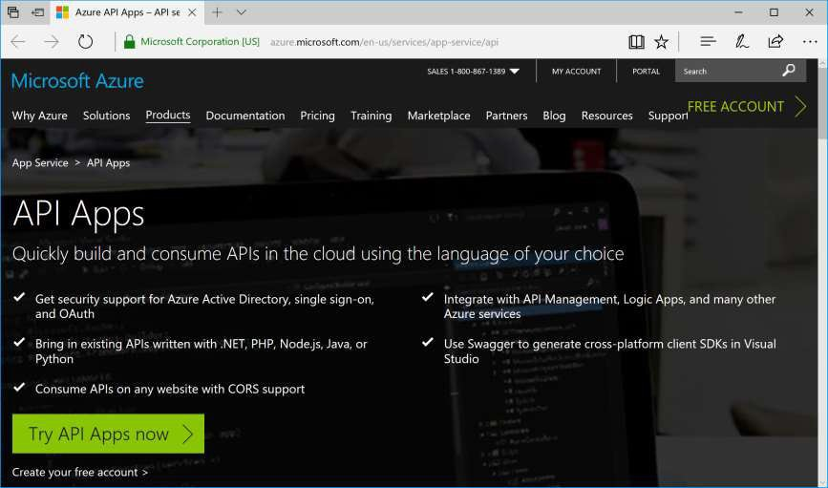
API Apps
Features:
Expose
Secure
Share
https://azure.microsoft.com/en-us/services/app-service/api/

Slide 14
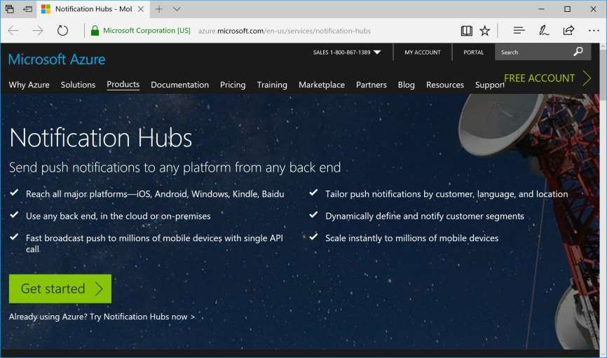
Notification Hubs
Platforms:
iOS
Android
Windows
Kindle
https://azure.microsoft.com/en-us/services/notification-hubs/

Slide 15
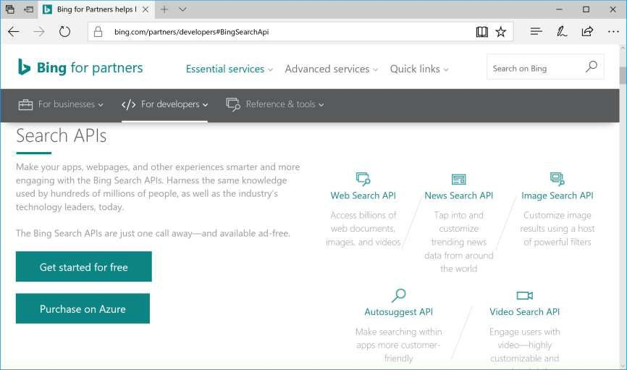
Bing Developer Center
Dev Center:
Web Search
News
Image Search
AutoSuggest
Video Search
Maps
Speech
Translator
Search
Synonyms
… and more!
https://www.bing.com/dev/

Slide 16
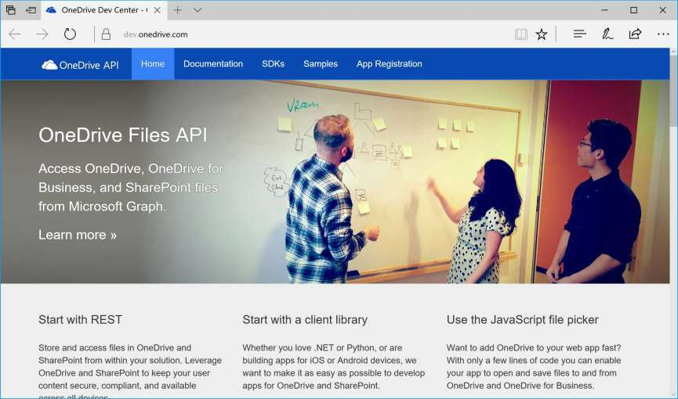
OneDrive API
Platforms:
Windows
iOS
Android
Web
https://dev.onedrive.com/

Slide 17
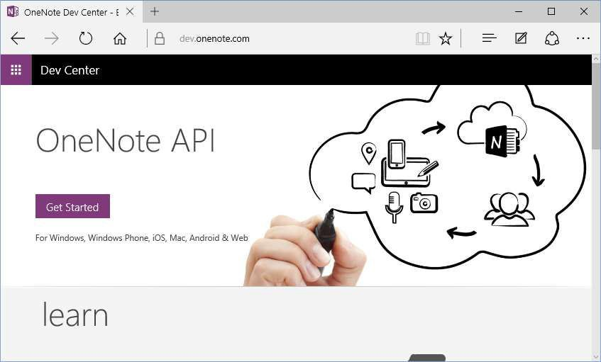
OneNote API
Platforms:
Windows
iOS
Mac
Android
Web
http://dev.onenote.com/

Slide 18
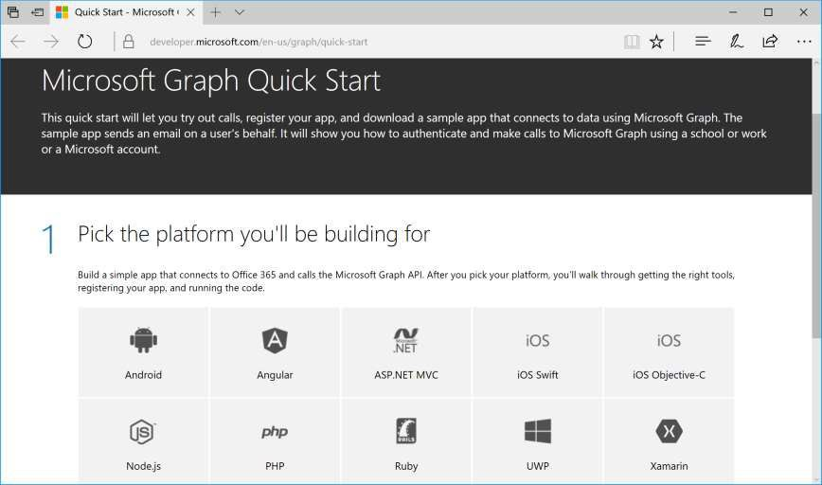
Microsoft Graph
Office365 Connect:
Android
Angular
ASP .NET MVC
iOS Swift
iOS Objective-C
Node.js
PHP
Ruby
Windows UWP
Xamarin
https://developer.microsoft.com/en-us/graph/quick-start

Slide 19
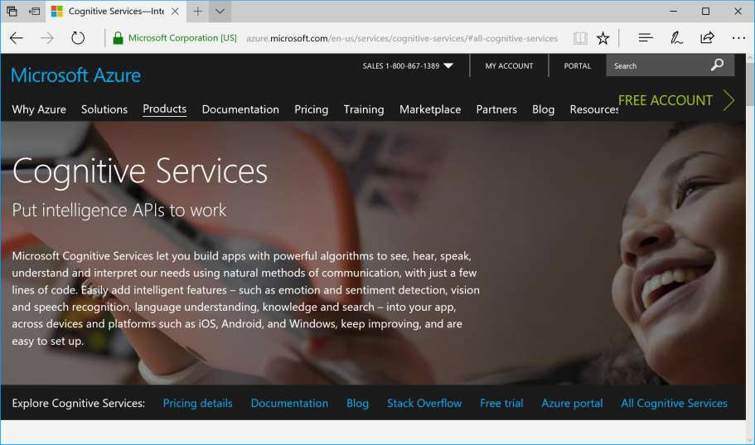
Cognitive Services
APIs Available:
Computer Vision
Face API
Emotion API
Video API
Video Indexer
Speech API
Translator API
QnA Maker API
… and more!
https://www.microsoft.com/cognitive-services/

Slide 20
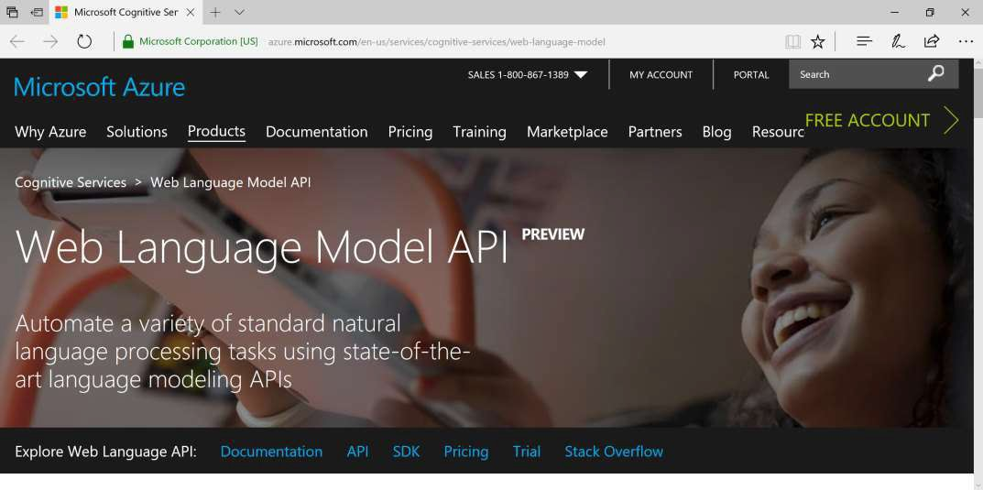
Natural Language Processing
https://www.microsoft.com/cognitive-services/en-us/web-language-model-api

Slide 21
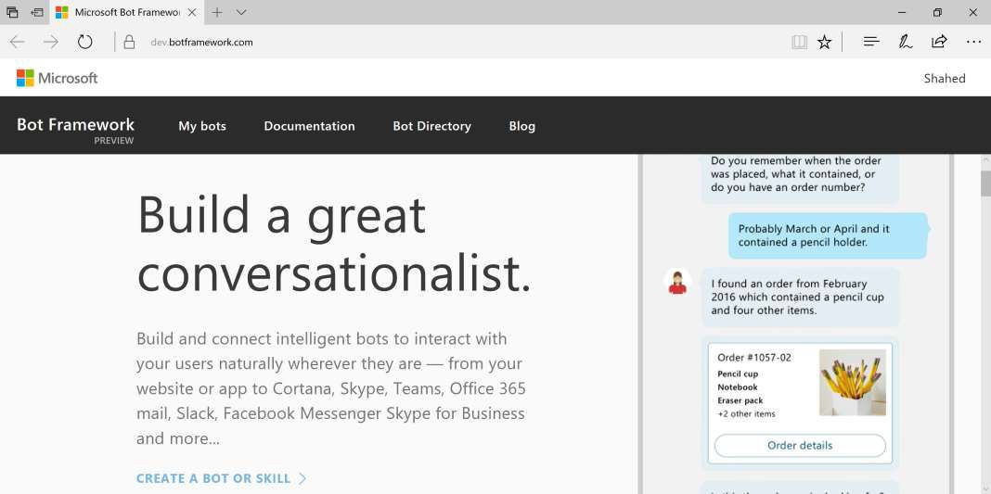
Bot Framework
https://dev.botframework.com/

Slide 22
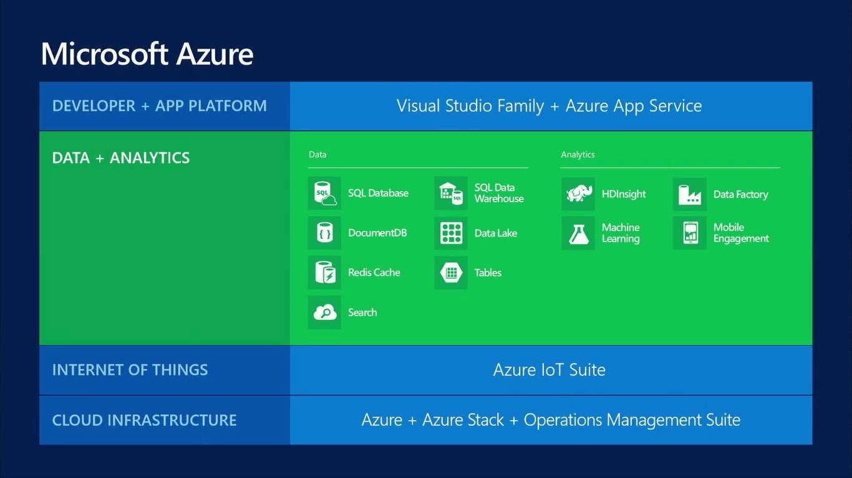

Slide 23
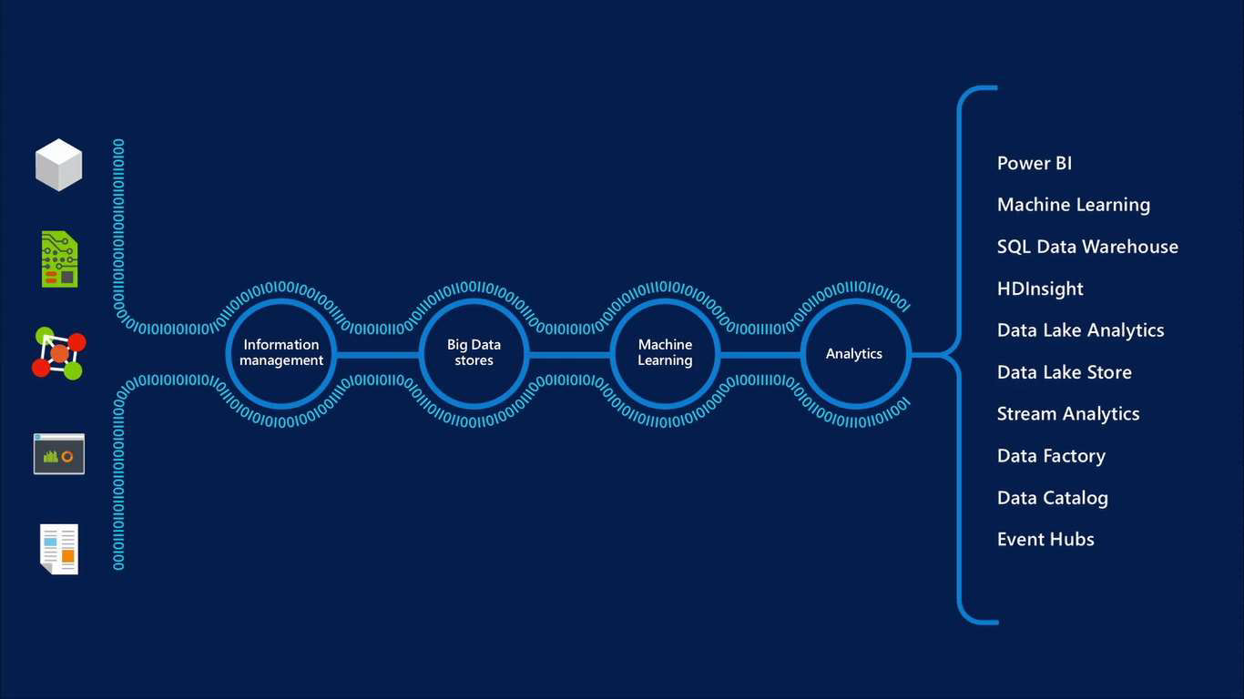

Slide 24









Database Options

Slide 25


SQL Database
Fully managed SQL Server database technology as a service
Ideal for simple and complex applications
Enterprise-ready with automatic support for HA
Secondary Replica
Primary
Secondary Replica
Secondary Replica

Slide 26
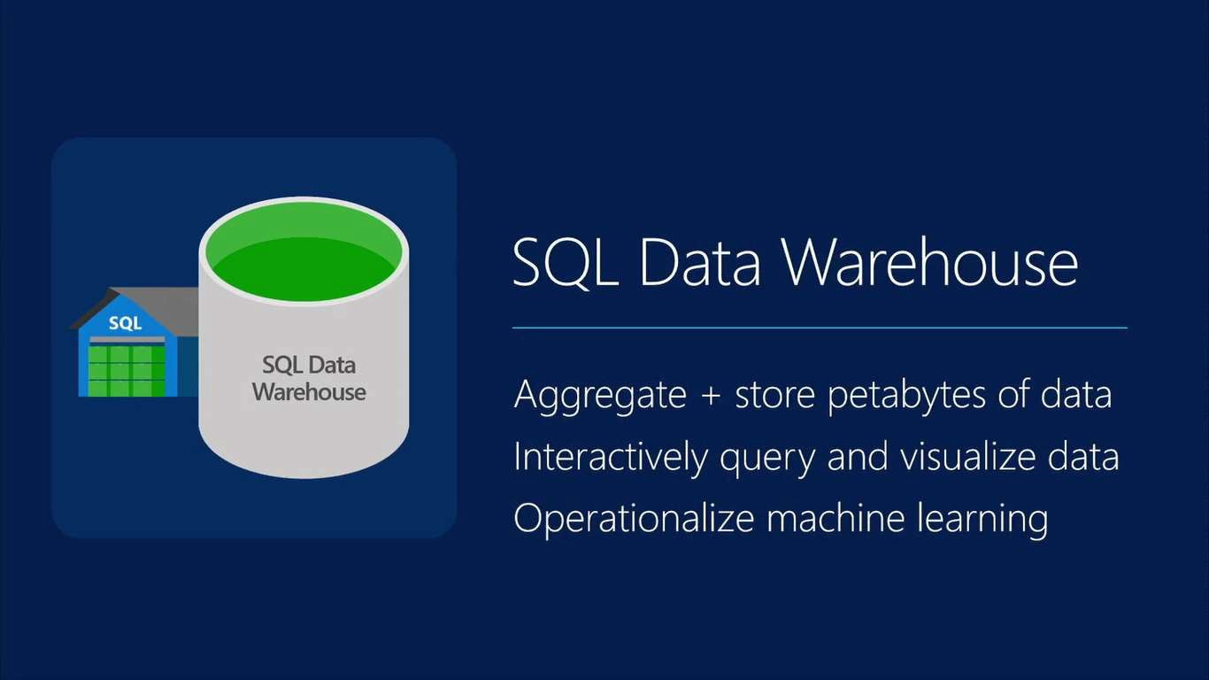

Slide 27
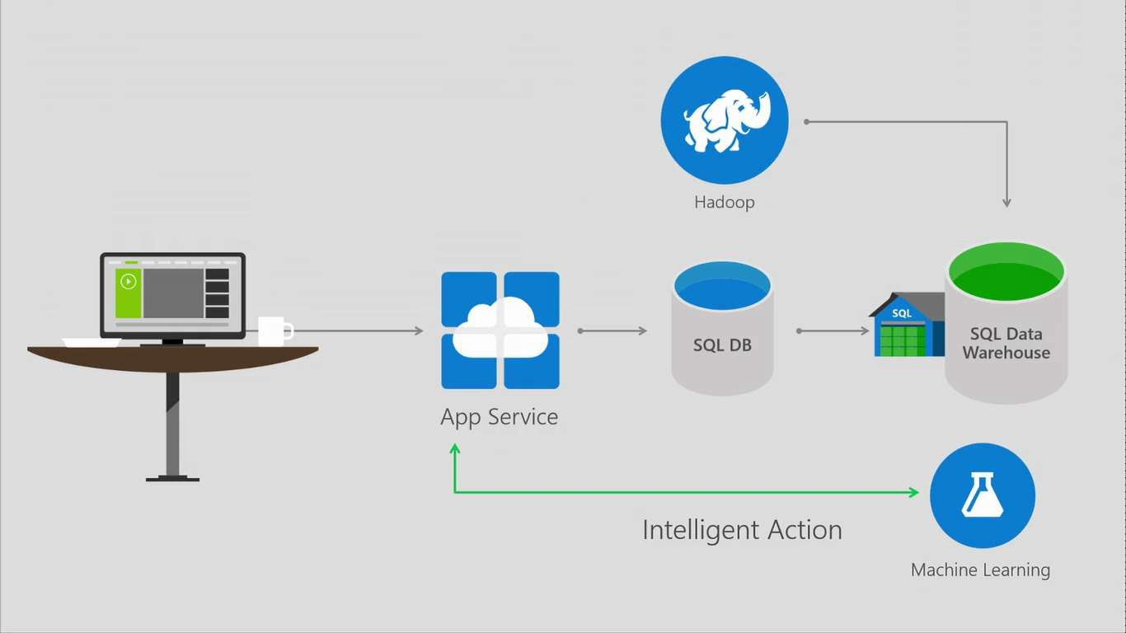

Slide 28
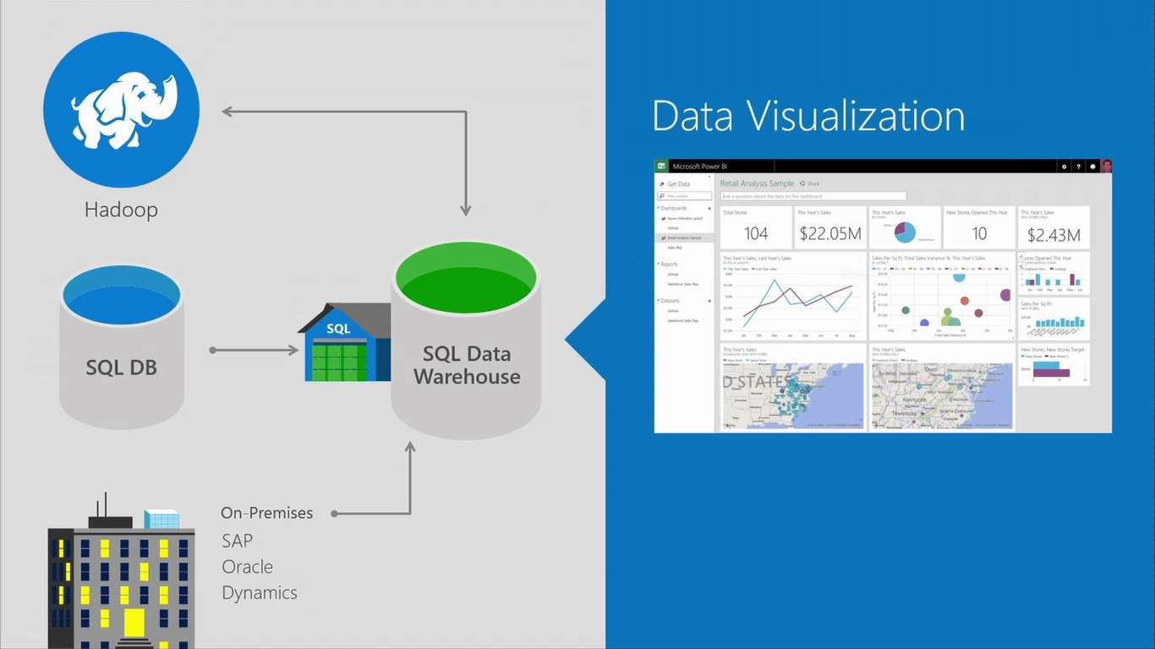

Slide 29
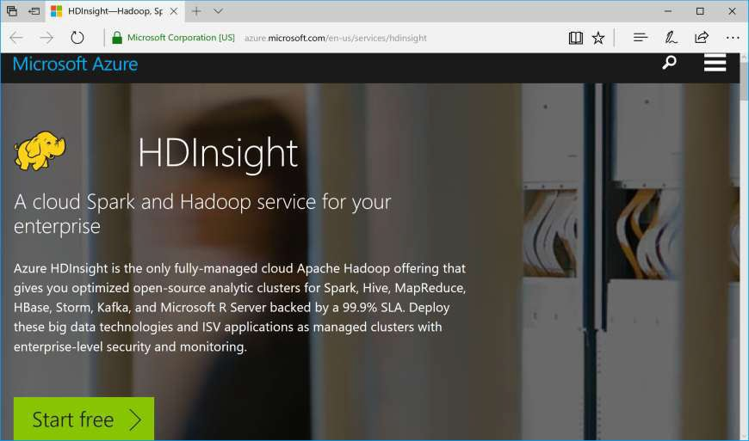
HDInsight: Big Data with Hadoop
Develop:
Java
.NET
… and more!
Deploy:
Windows
Linux
https://azure.microsoft.com/en-us/services/hdinsight/

Slide 30
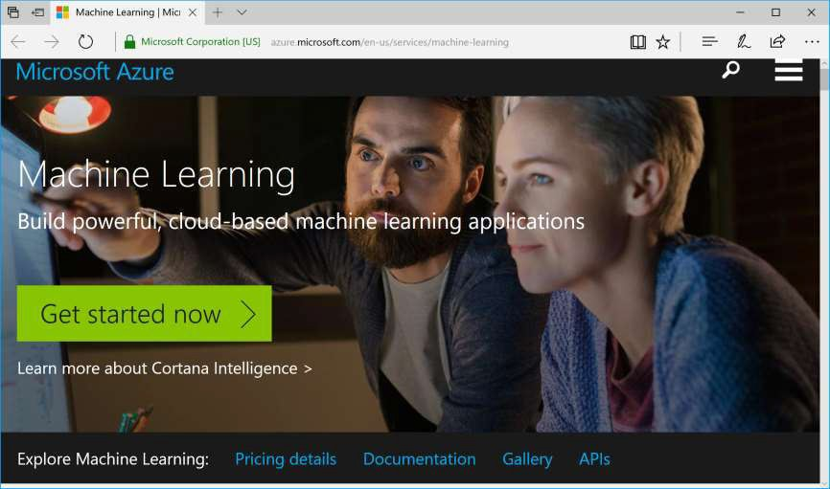
Machine Learning (Predictive Analytics)
Get Started!
Model
Deploy
Expand
https://azure.microsoft.com/en-us/services/machine-learning/

Slide 31

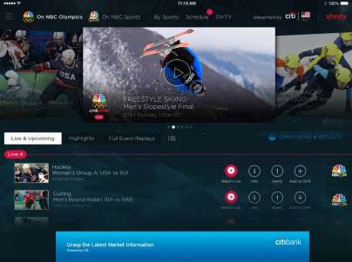
Azure Media Services
Olympics NBC Sports
On Demand Media Services
Video-on-demand
Ingest
Encode
Package
Encrypt
Delivery
Live Streaming Support
Office 365 Integration
Azure Media Player
Live video encoding and streaming Web + Mobile
100 million viewers
2.1 million concurrent HD viewers during the USA vs. Canada hockey match
https://azure.microsoft.com/en-us/services/media-services/

Slide 32
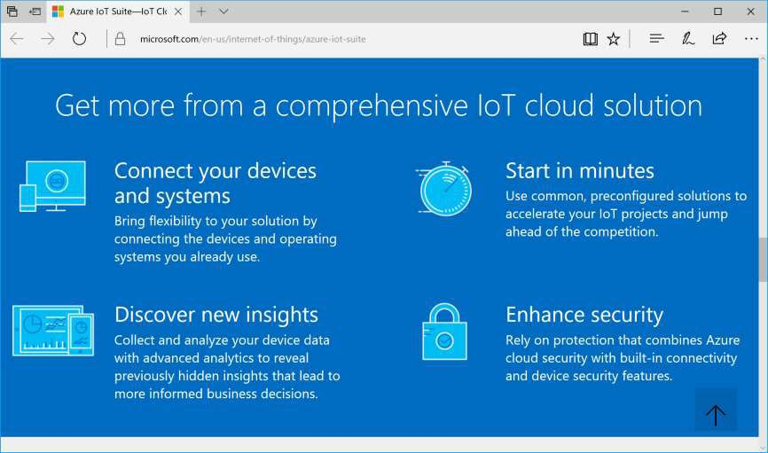
IoT (Internet of Things)
Iot Suite:
Connect
Monitor
Innovate
https://www.microsoft.com/en-us/internet-of-things/azure-iot-suite

Slide 33







Internet of Things
Event Hubs
Notification Hubs Stream Analytics Machine Learning
With Microsoft Azure IoT services, you can monitor assets to improve efficiencies, drive operational performance to enable innovation, and leverage advance data analytics to transform your company with new business models and revenue streams.
HDInsight
Power BI for Office 365

Slide 34
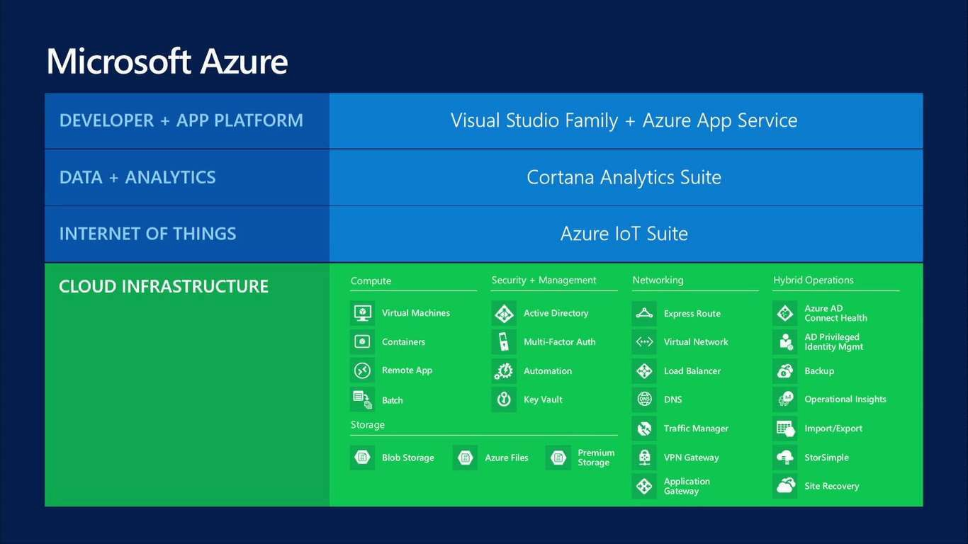

Slide 35
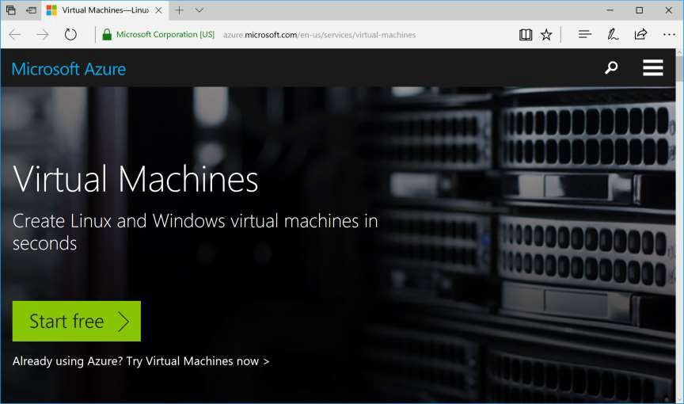
Virtual Machines
Options:
Windows
Linux
Pre-configured
https://azure.microsoft.com/en-us/services/virtual-machines/

Slide 36


Getting started
Select image
and VM size
New disk persisted
in storage
Management portal
Windows Server
Boot VM from new disk
>
Linux
Scripting
(Windows, Linux and Mac)
_
General Purpose
Basic Standard
Optimized Compute Performance Optimized Network Optimized
Blob Storage
REST API
Cloud
Comprehensive Networking
Virtual Machines

Slide 37
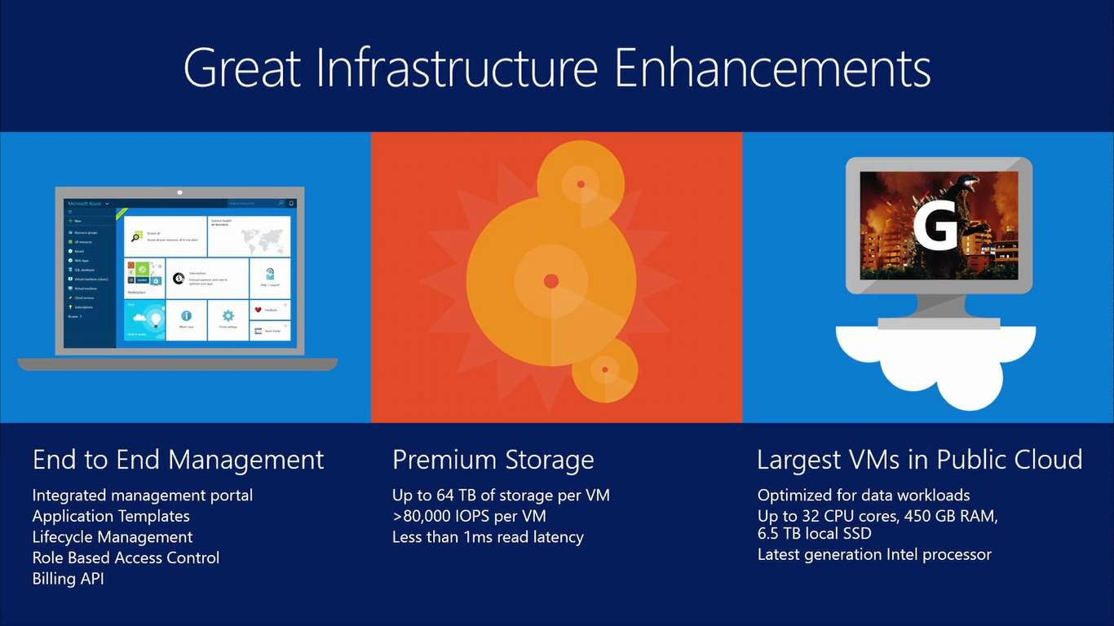

Slide 38
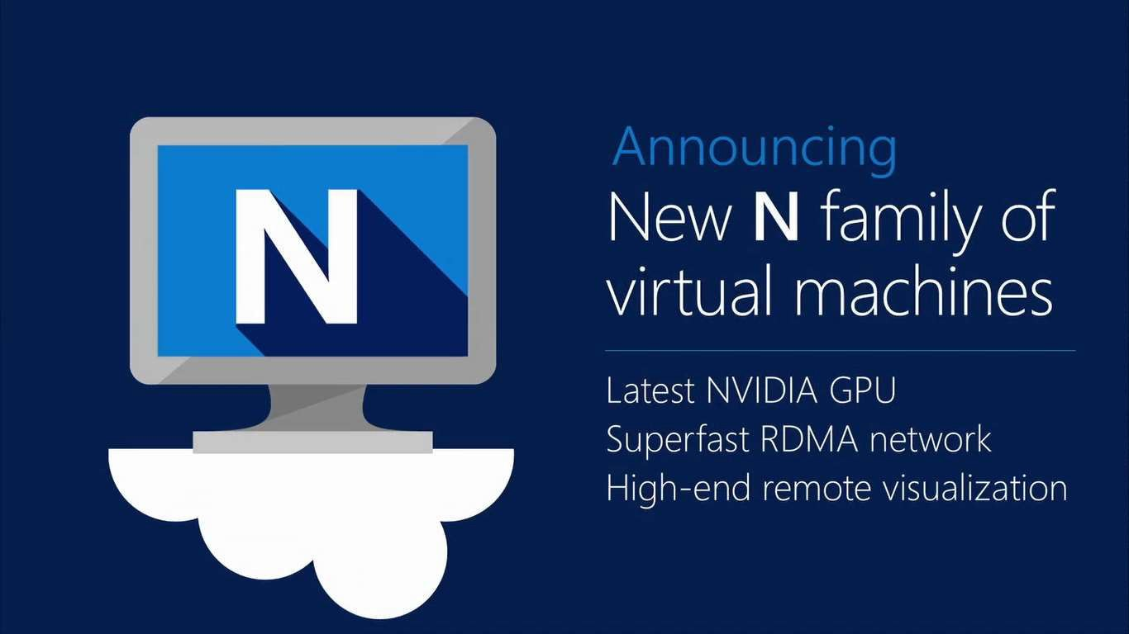

Slide 39





